Slide 1
Year 6 SATs 2020 Presentation for Parents, Carers & Guardians
2020

Slide 2
What are the SATs?
SATs is a term people use to refer to End of Key Stage 2 Assessments;
It lasts for four days beginning on Monday 11th May 2020 and ending on Thursday 14th May 2020;
Children will sit the following SATs papers: - Grammar, Punctuation and Spelling (Paper 1) – Monday 11th May 2020; - Grammar, Punctuation and Spelling (Paper 2) – Monday 11th May 2020; - Reading – Tuesday 12th May 2020; - Maths Paper 1 (Arithmetic) – Wednesday 13th May 2020; - Maths Paper 2 (Reasoning) – Wednesday 13th May 2020; - Maths Paper 3 (Reasoning) – Thursday 14th May 2020.
Writing is assessed using evidence collected by your child’s teacher throughout Year 6, so there is no Year 6 SATs writing test. However, the moderation for writing will be done externally in June and so children will need to have a bank of writing in order to be moderated. It is therefore imperative that no holidays are taken during this time.

Slide 3
When and how are the SATs carried out?
The tests will take place during normal school hours, under test conditions;
Children are not allowed to talk to each other from the moment the assessments are handed out until they are collected after the test has ended;
Afterwards, the completed papers are sent away to be marked externally;
The children’s results are sent back to school at some point in July;
The standard timings of tests differ: - Grammar, Punctuation and Spelling (Paper 1) – 45 minutes; - Grammar, Punctuation and Spelling (Paper 2) – 15 minutes; - Reading – 60 minutes; - Maths Paper 1 (Arithmetic) – 30 minutes; - Maths Paper 2 (Reasoning) – 40 minutes; - Maths Paper 3 (Reasoning) – 40 minutes.

Slide 4
Specific arrangements for SATs:
Children with additional needs may be allotted specific arrangements, including:
Additional (extra) time;
Tests being opened early to be modified;
An adult to read for them;
An adult to scribe (write) for them;
Written or spoken translations of the mathematics reasoning papers;
The use of prompts or rest breaks;
Arrangements for children who are ill or injured at the time of the tests.

Slide 5
What sort of results are reported?
Once marked, the tests will be given the following scores:
A raw score (the total number of marks achieved for each paper);
A scaled score (which is explained below);
A judgement of whether the National Standard has been met.
After marking each test, the external markers will convert each raw score into a scaled score to show whether each child is working below, at or above the national standard.
When the scaled score is given, it is given in a range from 80 to 120.
A scaled score of 100 or more is meeting the national standard.
There are no separate tests for higher achieving pupils; however, a scaled score of around 110 or above would show that a child is working at the higher standard

Slide 6
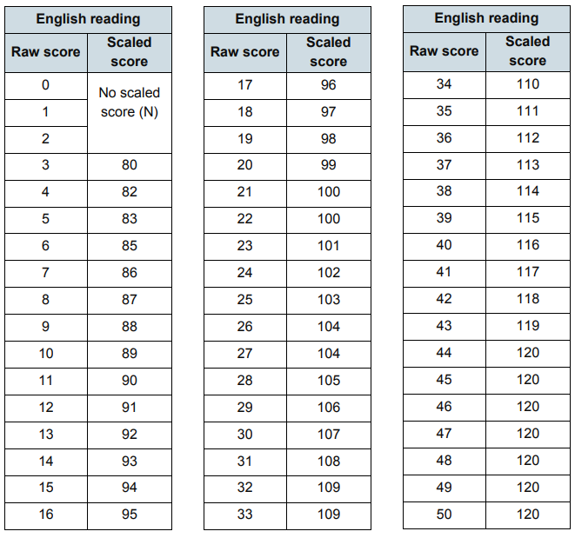

Slide 7
Grammar, Punctuation and Spelling
Grammar, Punctuation and Spelling is made up of two papers which will take place on Monday 11th May 2020:
Paper 1 is the longer paper lasting 45 minutes, children will be tested on grammar, punctuation and spelling generally
The children will be prepared by their class teacher so they are equipped with a good knowledge of the technical vocabulary needed to identify and describe various aspects of grammar and punctuation marks. Grammar, Punctuation and Spelling (Paper 1) requires a range of answer types such as circling missing capital letters, multiple choice questions, one-word answers, but does not require longer formal answers.
Paper 2 is a shorter paper lasting approximately 15 minutes, where children will be tested on spelling only – they are asked to fill in a blank within a sentence, attempting to spell out the spelling word in context correctly.

Slide 8
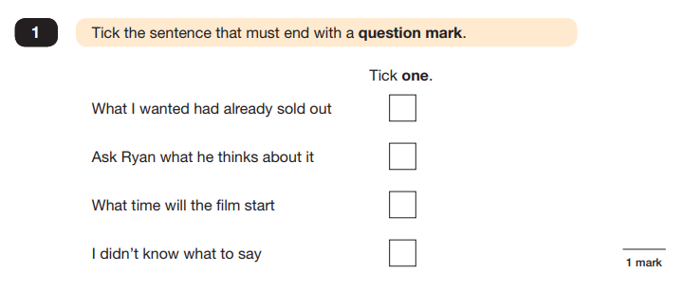
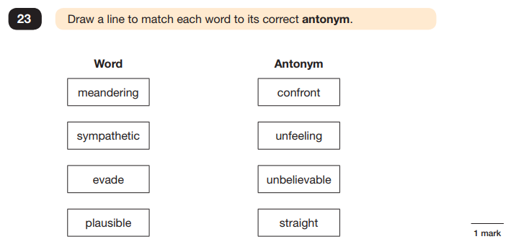
Grammar, Punctuation and Spelling (Paper 1)
Example questions:

Slide 9
Grammar, Punctuation and Spelling (Paper 2)
Grammar, Punctuation and Spelling (Paper 2) is the shorter paper lasting approximately 15 minutes, which takes place on Monday 11th May 2020.
Example questions:

Slide 10
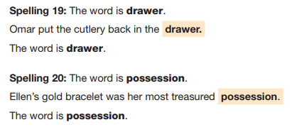
Grammar, Punctuation and Spelling (Paper 2)
Grammar, Punctuation and Spelling (Paper 2) is the shorter paper lasting 15 minutes, which takes place on Monday 11th May 2020.
Example questions:

Slide 11
Reading
The Year 6 Reading SATs paper will be sat on Tuesday 12th May 2020.
The assessment has been designed to measure whether children’s comprehension of age-appropriate reading material meets the national standard.
It a standard timing of 60 minutes, including reading the texts and answering questions. There are three different set texts for the children to read, which could be any combination of non-fiction, fiction and/or poetry.
The Year 6 Reading SATs paper requires a range of answering styles, including responding to multiple choice questions, one-word answers, and multiple mark questions which require more formal paragraph-length answers.

Slide 12
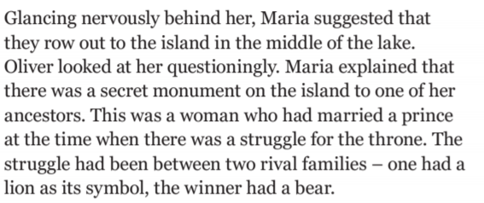
Reading
Example language question

Slide 13
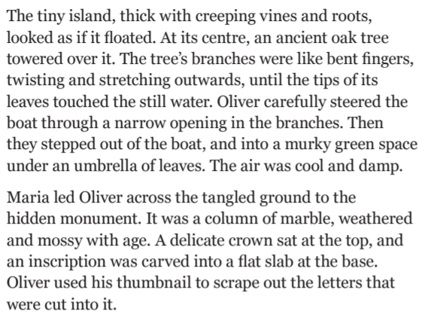
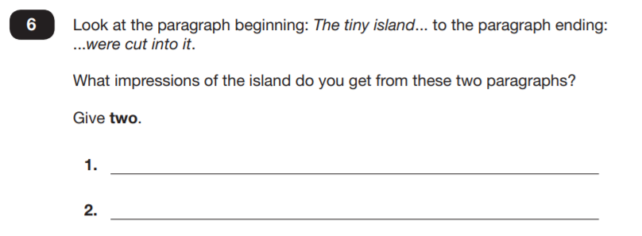
Example retrieval question:

Slide 14
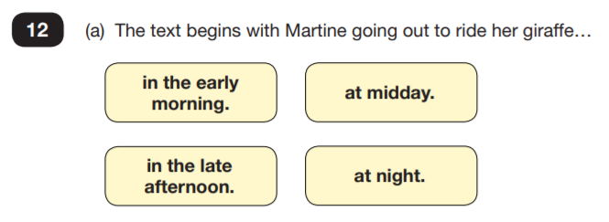
Example inference question.

Slide 15
Reading
Since the current testing format for the Year 6 SATs began in 2016, there has been a tendency for the number of marks to go in favour towards these particular types of content domain / questions.
For example, in 2019:
12% of marks could be gained by answering questions where children had to give/explain the meaning of words in context (Content Domain 2a);
Around 40% of the marks could be gained by answering questions where children had to retrieve/record information or details from the texts (2b);
Around 40% of the marks were allotted to questions requiring children to make inferences from a text, justifying inferences with text evidence (2d).
So, when reading with your child at home, try asking questions like:
Find a word in this paragraph that is closest in meaning to ‘provide word – e.g. annoyed’ (2a);
In what year did ‘provide fact – e.g. the French authorities make it illegal for people to swim from France to England’? (2b);
In the last paragraph, X does not want to Y. Give two reasons why X does not want Y. (2d)

Slide 16
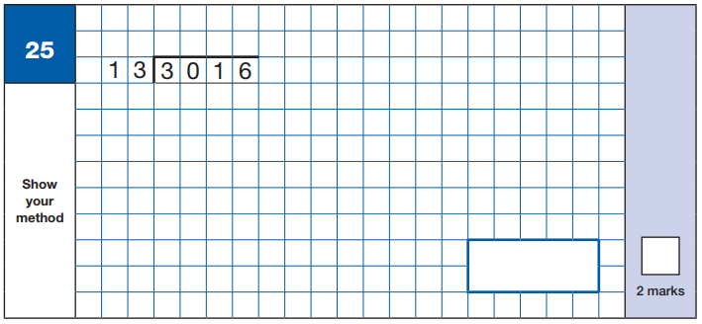
Maths Paper 1 (Arithmetic)
Maths Paper 1 (Arithmetic) will take place on Wednesday 13th May 2020.
It has a standard timing of 30 minutes and is worth a total of 40 marks.
It covers the four operations (division, multiplication, addition, subtraction and mixed operation calculations requiring BIDMAS), as well as number properties, calculating percentages of amounts, calculations using decimals, and calculations using fractions.
Example question:

Slide 17
Maths Paper 1 (Arithmetic)
Maths Paper 1 (Arithmetic) will take place on Wednesday 15th May 2019.
It has a standard timing of 30 minutes and is worth a total of 40 marks.
It covers the four operations (division, multiplication, addition, subtraction and mixed operation calculations requiring BIDMAS), as well as number properties, calculating percentages of amounts, calculations using decimals, and calculations using fractions.
Example question:

Slide 18
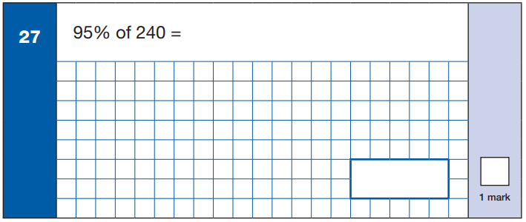
Maths Paper 1 (Arithmetic)
Maths Paper 1 (Arithmetic) will take place on Wednesday 13th May 2020.
It has a standard timing of 30 minutes and is worth a total of 40 marks.
It covers the four operations (division, multiplication, addition, subtraction and mixed operation calculations requiring BIDMAS), as well as number properties, calculating percentages of amounts, calculations using decimals, and calculations using fractions.
Example question:

Slide 19
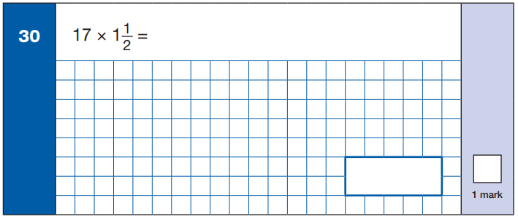
Maths Paper 1 (Arithmetic)
Maths Paper 1 (Arithmetic) will take place on Wednesday 13th May 2020.
It has a standard timing of 30 minutes and is worth a total of 40 marks.
It covers the four operations (division, multiplication, addition, subtraction and mixed operation calculations requiring BIDMAS), as well as number properties, calculating percentages of amounts, calculations using decimals, and calculations using fractions.
Example question:

Slide 20
Maths Papers 2 & 3 (Reasoning)
Maths Paper 2 (Reasoning) will take place on Wednesday 13th May 2020.
Maths Paper 3 (Reasoning) is scheduled for Thursday 14th May 2020.
Both have standard timings of 40 minutes and are worth 35 marks each.
Paper 2 requires children to demonstrate their mathematical knowledge and skills, as well as their ability to solve problems and their mathematical reasoning.
Questions focus on the following Mathematical topic areas: - Number and place value– including Roman Numerals; - Addition, subtraction, multiplication and division (calculations); - Geometry – properties of shapes; - Geometry – position and direction; - Statistics; - Measurement – including length, perimeter, mass (weight), volume, time and money; - Algebra; - Ratio and proportion; - Fractions, decimals and percentages.
The questions get harder throughout the paper.

Slide 21
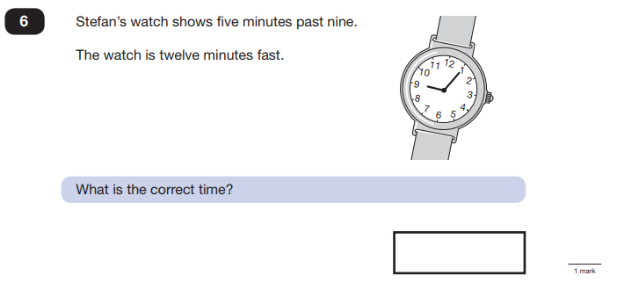
Maths Paper 2 (Reasoning)
Maths Paper 2 (Reasoning) will take place on Wednesday 13th May 2020.
Maths Paper 3 (Reasoning) is scheduled for Thursday 14th May 2020.
Both have standard timings of 40 minutes and are worth 35 marks each.
Example questions:

Slide 22
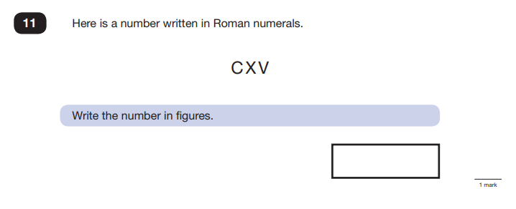
Maths Paper 2 (Reasoning)
Maths Paper 2 (Reasoning) will take place on Wednesday 13th May 2020.
Maths Paper 3 (Reasoning) is scheduled for Thursday 14th May 2020.
Both have standard timings of 40 minutes and are worth 35 marks each.
Example questions:

Slide 23
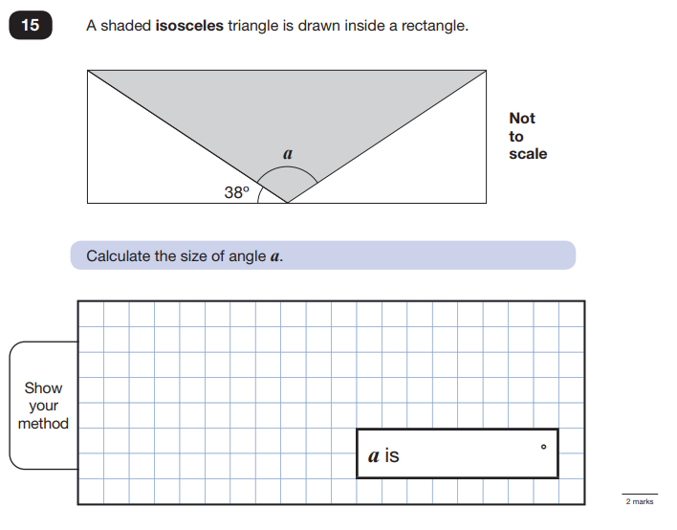
Maths Paper 2 (Reasoning)
Maths Paper 2 (Reasoning) will take place on Wednesday 13th May 2020.
Maths Paper 3 (Reasoning) is scheduled for Thursday 14th May 2020.
Both have standard timings of 40 minutes and are worth 35 marks each.
Example questions:

Slide 24
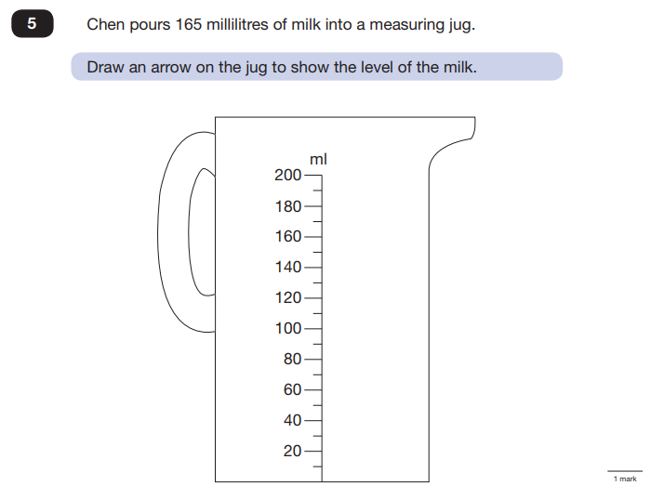
Maths Paper 3 (Reasoning)
Maths Paper 2 (Reasoning) will take place on Wednesday 13th May 2020.
Maths Paper 3 (Reasoning) is scheduled for Thursday 14th May 2020.
Both have standard timings of 40 minutes and are worth 35 marks each.
Example questions:

Slide 25
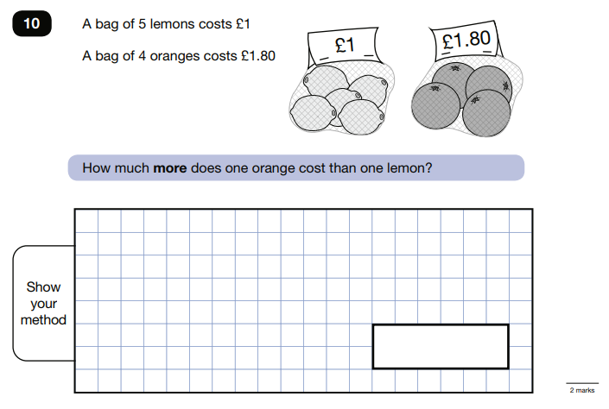
Maths Paper 3 (Reasoning)
Maths Paper 2 (Reasoning) will take place on Wednesday 13th May 2020.
Maths Paper 3 (Reasoning) is scheduled for Thursday 14th May 2020.
Both have standard timings of 40 minutes and are worth 35 marks each.
Example questions:

Slide 26
How can I support my child in preparing for their SATs?
Firstly, a positive attitude goes a long way – so as much encouragement and support as possible (but we don’t need to tell you that!)
Some further tips:
Avoid using past papers – we will provide you with examples of some revision books we have found appropriate. Some of these we will lend to you and others you can buy through us if you wish to have additional materials for home.
Block out some regular time when children can revise from their books and do their homework.
Ensure that children are reading regularly and sufficiently. Research has shown that volume of reading does have an impact on reading attainment.

Slide 27
How can I support my child in preparing for their SATs?
Firstly, a positive attitude goes a long way – so as much encouragement and support as possible (but we don’t need to tell you that!)
Some further tips:
Please can we ask that you practise telling the time on an analogue and digital clock. Also, please please help with times tables! It significantly speeds up their maths and this is crucial when there are time constraints on tests
Keep it light – practise things like mental maths in real world scenarios, like adding up prices in the shops, working out discount deals, and asking questions like, “If there are 1,300 grams of flour in this pack, what is that in kilograms?”
Please continue to support your child with their homework. We aim to send work home which reflects learning from school and allows children to consolidate their learning

Slide 28
How will we support your child?
Additional booster sessions
Targeted support through smaller sets
Purchase of SATS revision materials
A wide range of interventions
Thorough preparation using tasks in the style of the test papers so children aren’t fazed by the real thing. This will include mock SATS.
During SATS week, we will run ‘Cowley Carney Breakfast Café’ where children can come in earlier for a free breakfast and an opportunity to spend time with their friends and staff. These are fun, informal sessions that we feel are a successful way of reducing any stress the children may have.
The SATS tests themselves are organised in a way which is as stress-free as possible. For example, in classrooms in which the children are familiar and in smaller groups.

Slide 29
Remember this about SATs:
SATs focus on what they know about Maths and English
They won’t reflect how talented they are at Science, Geography, Art or PE, and they certainly won’t highlight positive personal characteristics such as kindness and integrity.

Slide 30
Thank you for coming and supporting us with your child’s continued learning.

